Slide 1

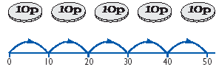
YEAR 5 – Autumn 1
Key Instant Recall Facts
This half term the children are working towards achieving their individual KIRF targets, indicated below.
The ultimate aim is for your child to be able to recall these facts instantly!
Know all multiplication and division facts up to 12 x 12.
Helpful hints
Create regular opportunities for rapid-fire questions where an instant correct answer is required.
Encourage children use what they already know, for example the 6x table is double the 3x table!
Chanting tables really does help. Make it fun by adding actions too or singing!
Don't forget to chant those division facts too, they are often much harder to recall.
Key vocabulary
times multiplied by lots of groups of multiple of divided by shared
product divisible by factor square number
How many 10 pence pieces make 50 pence?
Call out!
Play Fizz Buzz. To practise the 5 and 8 times tables together take it in turns to count in ones. If a number is in the 5 x table say 'Fizz' instead of the number. Say 'Buzz' if it's in the 8's and 'Fizz Buzz' if it's in both.
A vending machine is broken and only takes 5p coins. How many coins do you need to pay for a bar of chocolate that costs 45p?
Pick a domino, add the number of dots together then multiply by the table they are working on. To extend to all times tables, pick two dominoes to multiply the total number of dots on each together.
A piece of ribbon measure 56cm in total. 8 cm are needed to make a bow. How many bows can we make?
Remove picture cards from a pack of cards. Pick a card and treat the number as tenths. State the multiplication and division fact that the child is working on.
e.g. Pick the '8' card
so 7 x 0.8 = 5.6 and 5.6 divided by 7 is 0.8
There are lots of CDs available with musical tables. Great fun to sing along to on long car journeys!
Building confidence in mathematics is crucial so be pleased with your child’s efforts and always encourage with praise

Slide 2
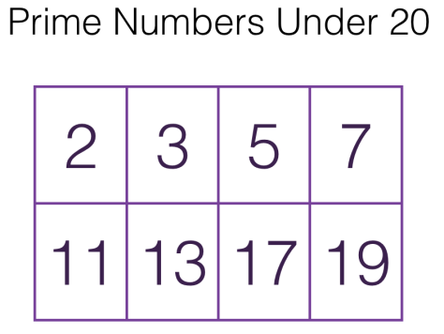
YEAR 5 – Autumn 2
Key Instant Recall Facts
This half term the children are working towards achieving their individual KIRF targets, indicated below.
The ultimate aim is for your child to be able to recall these facts instantly!
Know the doubles and halves of all two digit numbers.
Identify prime numbers up to 20.
Key vocabulary
multiply product times by lots of share group divide double near double
twice 2 lots of 2 times half halved divided by 2 shared between 2 group in pairs
Double
34 → 68
35 → 70
36 → 72
Halves
84 → 42
85 → 42 ½
or 42.5
86 → 43
What is 1/2 of 38?
Timed Games:
How well are you doing? How many questions can you answer in 2 minutes. Can you beat your own record?
1/2 of 30 = 15
1/2 of 8 = 4
So 1/2 of 38 must be 19!
Two tickets cost £67, how much would one ticket cost?
£33.50 I know because half of 60 is 30 and half of 7 is 3.5
The swimming pool is 3.7km away. How far will we travel there and back?
7.4km. Double 3 is 6 and double 0.7 is 1.4 which makes 7.4 altogether
Play number ping pong!
Start by saying 'ping', child replies with 'pong'.
Repeat and then convert to numbers i.e. say 3.9' and they reply '7.8' (double 2 digit decimal) Or say, '7.8' and they say '3.9'
A prime number is a whole number greater than 1 whose only factors are 1 and itself. A factor is a whole numbers that can be divided evenly into another number.
Building confidence in mathematics is crucial so be pleased with your child’s efforts and always encourage with praise. Make sure these practice sessions are enjoyable - if your child is really not in the mood it is the wrong time to be practising!

Slide 3
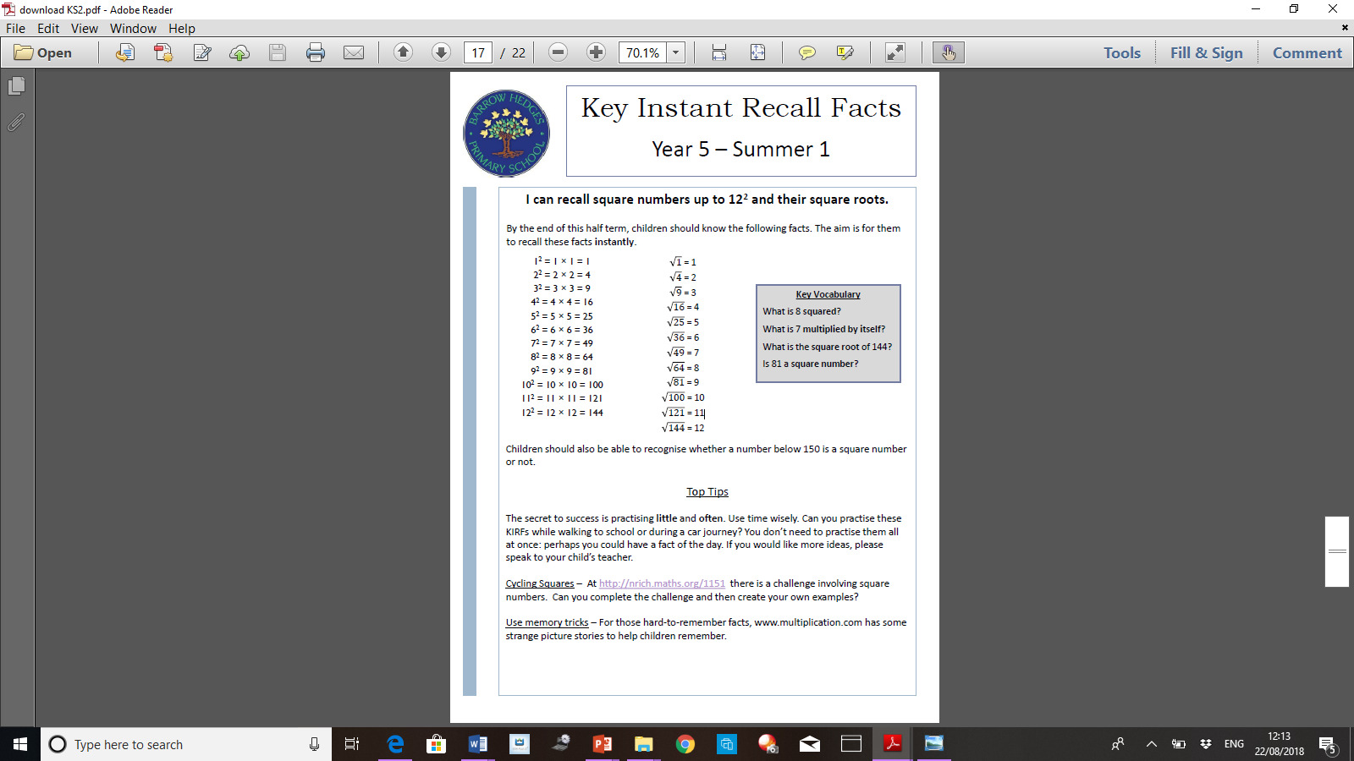
YEAR 5 – Spring 1
Key Instant Recall Facts
This half term the children are working towards achieving their individual KIRF targets, indicated below.
The ultimate aim is for your child to be able to recall these facts instantly!
I know all pairs of factors of numbers up to 100.
I can recall square numbers up to 12² and their square roots.
Factors are numbers that you can multiply together to get a greater number.
These are best learnt as pairs and, if times table knowledge is strong, should come easily!
Play games to make this fun…
‘Find The Factors!’
“You have 1 minute to find as many pairs of factors of 60 as possible!”
‘Missing Factors’
“Can you spot the missing factors for 48 in this list?”
Factors of 24
1
24
X
4
6
24
8
X
3
X
2
12
X
so there are 8 factors of 24....
1, 2, 3, 4, 6, 8, 12 and 24
Building confidence in mathematics is crucial so be pleased with your child’s efforts and always encourage with praise. Make sure these practice sessions are enjoyable - if your child is really not in the mood it is the wrong time to be practising!

Slide 4





YEAR 5 – Spring 2
Key Instant Recall Facts
This half term the children are working towards achieving their individual KIRF target, indicated below. The ultimate aim is for your child to be able to recall these facts instantly!
Know the tests for divisibility for 2, 3, 5, 9 and 10.
Divisible by 2:
Divisible by 5:
Rule: If it ends with a 0, 2, 4, 6, or 8
Rule: If it ends with a 5 or a 0
Divisible by 3:
Divisible by 9:
Rule: If the sum of the digits is a multiple of 3
Rule: If the sum of the digits are a multiple of 9
Divisible by 10:
Rule: If the last digit is 0
Building confidence in mathematics is crucial so be pleased with your child’s efforts and always encourage with praise.

Slide 5
YEAR 5 – Summer 1
Key Instant Recall Facts
This half term the children are working towards achieving their individual KIRF targets, indicated below.
The ultimate aim is for your child to be able to recall these facts instantly!
Know all decimal number bonds to 1 and 10. (1 decimal place).
All decimal bonds
for 1:
0.1 + 0.9 = 1
0.2 + 0.8 = 1
0.3 + 0.7 = 1
0.4 + 0.6 = 1
0.5 + 0.5 = 1
0.6 + 0.4 = 1
0.7 + 0.3 = 1
0.8 + 0.2 = 1
0.9 + 0.1 = 1
1.0 + 0.0 = 1
Example of decimal bonds for 10:
Call out!
Play number ping pong!
Start off saying 'ping', child replies with ‘pong'.
Repeat and then convert to numbers i.e. say '0.3' and they reply '0.7' (decimal bonds for 1)
6.2 + 3.8 = 10; 3,8 + 6.2 = 10
so
10 - 6.2 = 3.8; 10 - 3.8 = 6.2
4.9 + 5.1 = 10; 5.1 + 4.9 = 10
so
10 - 4.9 = 5.1; 10 - 5.1 = 4.9
Helpful hints:
Create regular, short opportunities for rapid-fire questions where an instant correct answer is required.
Use objects to consider the bonds in a practical way.
Look at the patterns with both objects and numbers e.g. as one number increases the other one decreases.
Practise with the numbers in order AND chosen randomly - remember the aim is for your child to be able to respond immediately.
Key vocabulary
How many more to make? altogether make sum total
how much more is…than…? difference between
Building confidence in mathematics is crucial so be pleased with your child’s efforts and always encourage with praise. Make sure these practice sessions are enjoyable - if your child is really not in the mood it is the wrong time to be practising!

Slide 6
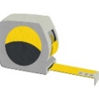
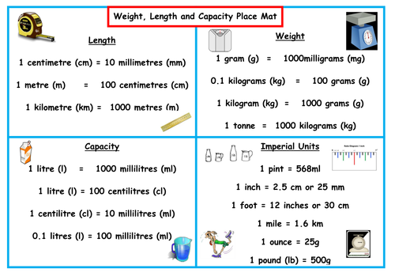
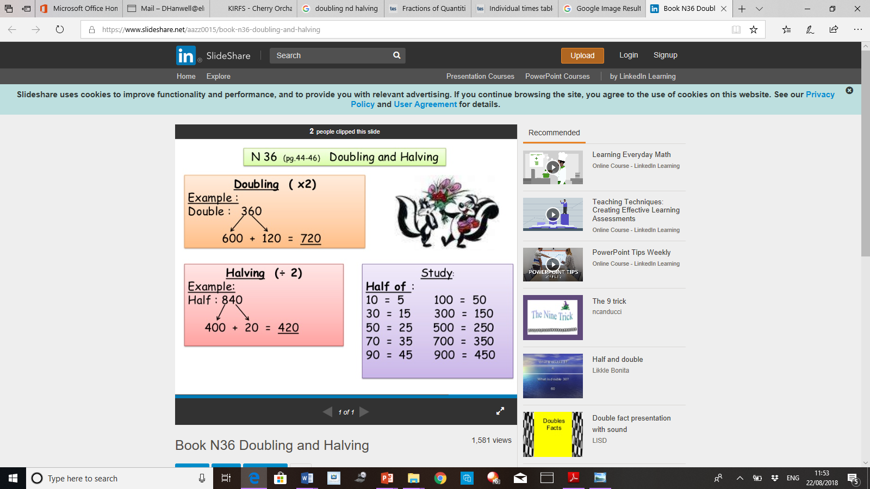
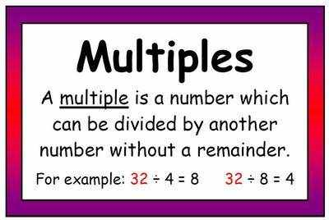
YEAR 5 – Summer 2
Key Instant Recall Facts
This half term the children are working towards achieving their individual KIRF targets, indicated below.
The ultimate aim is for your child to be able to recall these facts instantly!
Know doubles and halves of all whole numbers to 100, all multiples of 10 to 1000 and all multiples of 100 to 10,000.
Recall metric conversions.
Multiples of 10:
10, 20, 30, 40, 50, 60, 70, 80, 90, 100, 110, 120, 130, 140, 150 160 etc.
Multiples of 100:
100, 200, 300, 400, 500, 600, 700, 800, 900, 1000, 1100, 1200, 1300, 1400, 1500, 1600 etc.
Building confidence in mathematics is crucial so be pleased with your child’s efforts and always encourage with praise. Make sure these practice sessions are enjoyable - if your child is really not in the mood it is the wrong time to be practising!

